Slide 1
Sampling, Reconstruction and Aliasing Review of Complex Exponentials and Fourier Analysis

Slide 2
Digital Signal Processing System
Microcontroller
(ARM Cortex-M4)
Digital
Signal
processor
ADC
DAC
Analogue input signal
Analogue output signal
CODEC on the audio card
Notes:
A basic digital signal processing system implemented using an ARM Cortex-M4 based EVM and an audio card is the focus of the DSP LiB experiments/materials.
The diagram on this slide is more generally applicable than that.
In order to apply DSP to continuous-time analogue signals, the input signal must be converted into digital form (sampling and quantisation) and the digital output signal must be converted back to continuous-time analogue form – it must be reconstructed from digital sample values.

Slide 3
Pre-requisite Theory
Complex exponentials
Continuous-time Fourier transform
- properties
- important Fourier transform pairs
Notes:
In order to gain some insight into the sampling and reconstruction processes, some theoretical knowledge is useful. You may well have acquired this already if you have studied engineering mathematics or linear system theory. The purpose of these materials is not to teach you that theory but in the following slides some key results from that wider background will be highlighted and reviewed. These particular results are particularly useful in understanding sampling and reconstruction. In order to do this it is very useful to be familiar/comfortable with the concept of signal representation in both the time-domain and in the frequency-domain. At the end of he day, this is what the Fourier transform is all about – Fourier analysis describes the transformations between time and frequency-domain representations of a signal. If you like, time-domain signals are described in terms of the (complex) values of each of an infinite number of weighted dirac functions (unit impulses) separated infinitesimally in time, while the corresponding function (to the dirac function) in the frequency domain is a complex exponential.
Frequency-domain signals are described in terms of the (complex) values of each of an infinite number of weighted dirac functions (frequency components) separated infinitesimally in frequency.

Slide 4
The Fourier Transform
complex, continuous, aperiodic
inverse Fourier
transform
complex, continuous, aperiodic
forward Fourier
transform
Complex exponentials are a fundamental part of Fourier analysis and frequency domain
representation of signals
Notes:
Sometimes the Fourier transform is defined with the two pi scaling factor applied in the forward transform. This is not a big deal since it is literally just a scaling factor applied to a linear transform.
Complex exponentials are a fundamental part of Fourier analysis and it is well worth reviewing what these represent. They are the key to understanding negative frequencies.

Slide 5
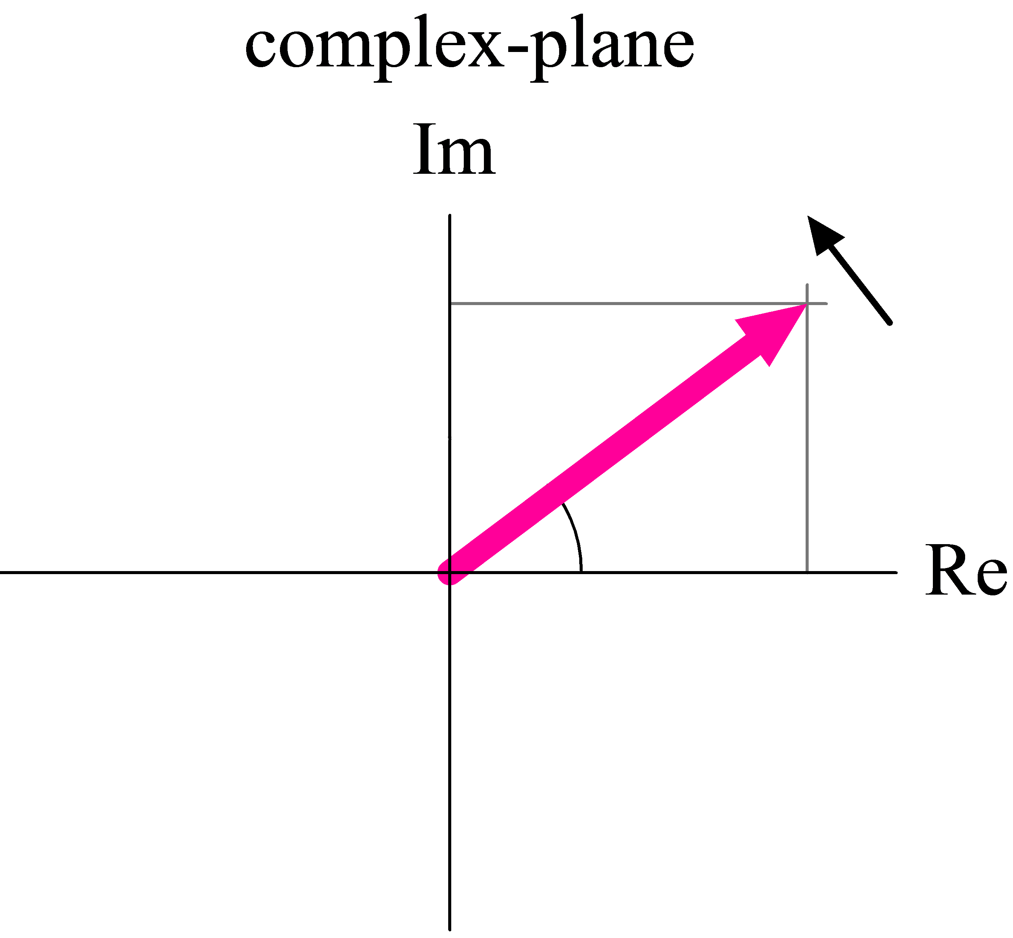
Complex Exponentials
Complex exponential represented in three different ways
Complex-plane
Time-domain
Frequency-domain
Euler’s formula:
Notes:
A complex exponential may be viewed in a variety of different ways. It may be considered as a phasor (a vector rotating with angular velocity ω) in the complex-plane, or the real and imaginary parts of that phasor may be plotted against time. In the frequency-domain, a complex exponential may be considered as having a fixed frequency and a complex value at t = 0. Hence it will appear as impulses on both real and imaginary frequency domain plots at ω along the frequency axis.
The weights of the real and imaginary impulses shown in the frequency domain correspond to the real and imaginary parts of the time domain phasor at t = 0.
In this example, at t = 0 the imaginary part of the phasor is equal to zero and the real part of the phasor is equal to A . Hence, in the frequency domain the signal is represented by an impulse of weight A at frequency ω on the real axes and nothing on the imaginary axes.

Slide 6
Complex Exponentials
Complex exponential represented in three different ways
Complex-plane
Time-domain
Frequency-domain
Euler’s formula:
Notes:
A phasor rotating clockwise in the complex plane is regarded as having negative frequency. Phase angle ωt in the complex plane is measured anticlockwise from real axis. The real part of this signal is similar to that of the anticlockwise rotating phasor shown in the previous slide. Remember that cos(-x) = cos(x), and sin(-x) = -sin(x)!
All of this is fairly theoretical – has anyone ever seen an imaginary part of a time-domain signal on an oscilloscope?
Complex time-domain signals are considered in (quadrature) communications systems.

Slide 7
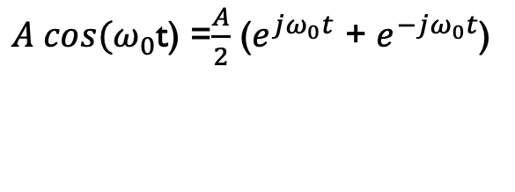
Real-valued Cosine
$A cos(ω_{0}$t) =$\frac{A}{2}$ ($e^{jω_{0}t}$ + $e^{−jω_{0}t}$)
Real-valued sinusoid represented in three different ways
Complex-plane
Time-domain
Frequency-domain
1
1
1
Notes:
Based on Euler’s formula, a real-valued signal may be synthesised from contra-rotating phasors. Real-valued sinusoidal signals such as we might encounter in the laboratory may be represented by pairs of complex exponentials in the frequency domain.

Slide 8
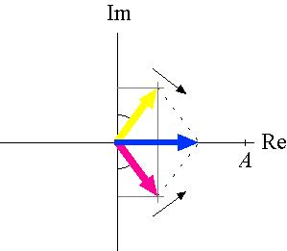
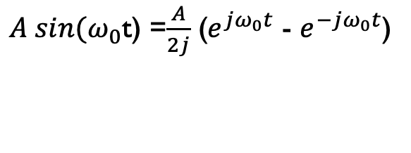
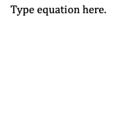
Real-valued Sine
$A sin(ω_{0}$t) =$\frac{A}{2j}$ ($e^{jω_{0}t}$ - $e^{−jω_{0}t}$)
Real-valued sinusoid represented in three different ways
Complex-plane
Time-domain
Frequency-domain
−ω₀
+ω₀
Notes:
All of the quantities considered in the Fourier transform are complex.

Slide 9
Fourier Transform of an Impulse
d(t) is zero for t ≠ 0 and over an infinitesimal interval of time around t = 0 (for which the complex exponential term is equal to 1) its integral with respect to time is equal to unity, and hence
0
Notes:
This is the first of several important Fourier transform pairs that are worth committing to memory. Doing so will make it easier to understand the representation of signals in both time and frequency domains and to understand some, if not all, digital signal processing operations. Don’t worry overly about the mathematics – just remember that an impulse (at t = 0) corresponds to a constant in the frequency domain. An impulse contains equally weighted frequency components over an infinite range of frequencies.

Slide 10
Fourier Transform of a Constant
The inverse Fourier transform of a constant is equal to an impulse
Substitute for and for
0
an impulse in the frequency domain
the Fourier transform of unity in
the time domain
This is an example of the duality property of the FT
Notes:
Noting the similarity of form of the equations for the FT of a constant and for the inverse FT of a constant and by changing variable names we can demonstrate that the Fourier transform of a constant in the time-domain is an impulse in the frequency-domain. Note that d(w) = d(-w).
This is an example of the duality property of the Fourier transform.

Slide 11
Duality Property
Notes:
Formal statement of the duality property.
X(ω) is the Fourier transform of x(t).
2 pi x(-ω) is the FT of X(t).

Slide 12

Fourier Transform of a Rectangular Pulse
$$τ$$
Notes:
The Fourier transform of a rectangular pulse in the time-domain, is a sinc function in the frequency-domain. Normalised, and un-normalised (above) definitions of the sinc function exist. Notice that while the representation of this signal in one domain (time) is finite in extent, the representation in the other domain (frequency) is infinite in extent.

Slide 13
sinc function
normalised sinc function
un-normalised sinc function
Notes:
The sinc function, or sin(x) over x function has two commonly used forms. The previous slide used the un-normalised form. One has zero crossings at integer values of x the other has zero crossings, or nulls, at integer multiples of pi.

Slide 14
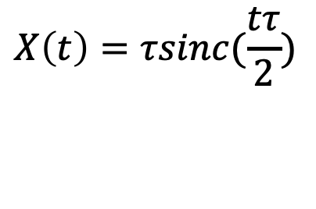
Fourier Transform of a sinc Function
Using the duality property and the previous result,
$$X\left(t\right)=τsinc(\frac{tτ}{2})$$
is the Fourier transform of
Notes:
Using the duality property, the Fourier transform of a sinc function is a rectangular pulse in the frequency-domain.

Slide 15
Scaling Property of the Fourier Transform
If
then
where is a real-valued constant
Widening a function in one domain corresponds to narrowing its representation in the other
Notes:
As a function widens (is stretched, while maintaining its form) in one domain, its representation in the other domain narrows (is compressed, while maintaining its form). Illustrated above are two rectangular pulses of different durations in the time domain. You might wish to ponder what would happen if the rectangular pulse were stretched out to have infinite duration, or compressed to have infinitesimal duration and to recall the Fourier transforms of an impulse and of a constant.

Slide 16
Frequency Shifting Property
Multiplication of a time-domain function by a complex exponential shifts its frequency domain representation along the frequency axis.
Notes:
Multiplying a time-domain function by a complex exponential shifts its frequency-domain representation along the frequency axis. This property is closely related to ...

Slide 17
Convolution Property
If
and
then
and
Convolution in the time-domain is equivalent to multiplication in the frequency-domain.
Notes:
... the convolution property. Shifting a function along the frequency axis (by ω) is equivalent to convolving it with an impulse in the frequency domain (at frequency ω). As we saw when we considered phasors, an impulse in the frequency domain at frequency ω corresponds to a complex exponential in the time domain. Didn’t we just multiply our time-domain function by a complex exponential?
This is a very important result pertaining to the implementation and behaviour of linear time-invariant systems.

Slide 18
Fourier Transform of a Sinusoid
Use the frequency shifting property
and the previous result that
A
t
Notes:
We’ve already seen this example when we considered phasors (although because of the way in which we’ve defined the Fourier transform there is a two pi scaling factor difference here). The Fourier transform, or frequency-domain representation, of a real-valued cosine of frequency ω is two impulses at frequencies +/- ω.

Slide 19
Even and Odd Functions
Even function
Odd function
x(t) | X(ω)
real-valued and even | real-valued and even
real-valued and odd | imaginary and odd
imaginary and even | imaginary and even
imaginary and odd | real-valued and odd
Notes:
So far, all of the example functions/signals presented (impulse, constant, rectangular pulse, sinc function, cosine) and their Fourier transforms have been real valued. Earlier, we drew axes for the imaginary parts of time-domain and frequency-domain representation of complex exponentials but in the last few slides we’ve not had to do that. All of the example functions (and their Fourier transforms) were real-valued and even functions of both time and frequency!
As stated previously, in general (and if we consider a function as straightforward as a sine) we must remember that both x(t) and X(w) are complex.

Slide 20
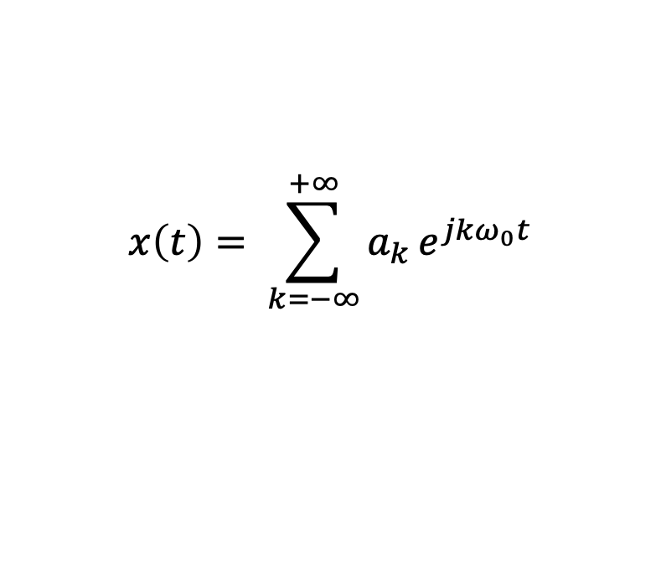
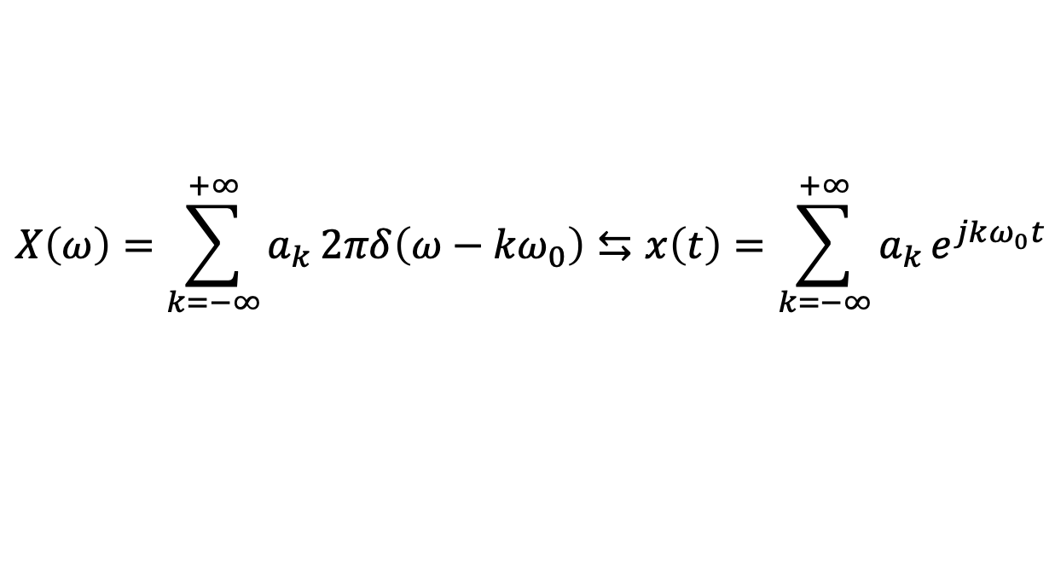
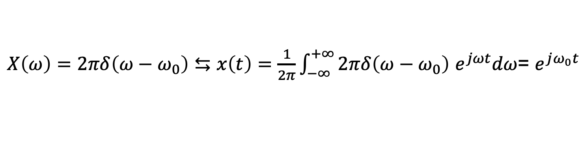
Fourier Transform of a periodic signal
A periodic signal, x(t), can always be written as a Fourier series, with Fourier series coefficients a_{k} so that:
Now remember
Therefore
$$x\left(t\right)= \sum_{k=−∞}^{+∞}{a_{k}}e^{jkω_{0}t}$$
$X\left(ω\right)=2πδ\left(ω−ω_{0}\right)⇆x\left(t\right)=\frac{1}{2π}\int_{−∞}^{+∞}{2πδ\left(ω−ω_{0}\right)}$ $e^{jωt}dω$= $e^{jω_{0}t}$
$$X\left(ω\right)=\sum_{k=−∞}^{+∞}{a_{k}}2πδ\left(ω−{kω}_{0}\right)⇆x\left(t\right)={\sum_{k=−∞}^{+∞}{a_{k}}e}^{jkω_{0}t}$$
The Fourier transform of a periodic signal is the sum of 2πa₀ and an infinite train of impulses centred at multiple of the fundamental frequency weighted by 2π times its spectral coefficients a_{k}.

Slide 21
Fourier Transform of an Impulse Train
An infinite train of impulses in the time-domain
(sometimes known as the Shah function)
is interesting because (allowing for scaling) its Fourier transform is itself,
i.e. an infinite train of impulses in the frequency domain
The Fourier transform of an infinite train of impulses in the time-domain is an infinite train of impulses in the frequency-domain.
Notes:
Finally, here is one more fundamental Fourier transform pair that is worth committing to memory.
How freaky is this? A function whose Fourier transform is itself! There is at least one other function with the same property – the Gaussian.
The name Shah function derives from the shape of the cyrillic character.

Slide 22
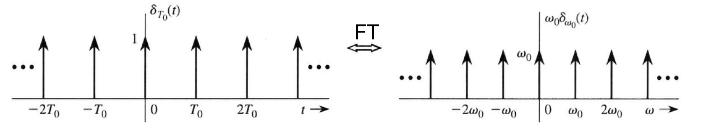
Fourier Transform of an Impulse Train
Notes:
Finally, here is one more fundamental Fourier transform pair that is worth committing to memory.
How freaky is this? A function whose Fourier transform is itself! There is at least one other function with the same property – the Gaussian.
The name Shah function derives from the shape of the cyrillic character.

